Slide 1
RISC V 32IME
By Sukruth S

Slide 2
Objectives to be done
ISA consisting of R,I and j type of instruction
12 instructions over all
Forwarding and stalling hazards avoidance architecture
Flushing unit for control hazard
Testing and optimization

Slide 3
Proposed design
Instruction
Fetch
Instr. Decode
Reg. Fetch
Execute
Addr. Calc
Memory
Access
Write
Back
Stall Controller
stall control
IF/ID
ID/EX
EX/MEM
Stage MEM
MEM/WB
Stage IF
Stage ID
Stage EX
PC Reg
I-Cache
Register
File
D-Cache
ALU
Memory
data forwarding

Slide 4
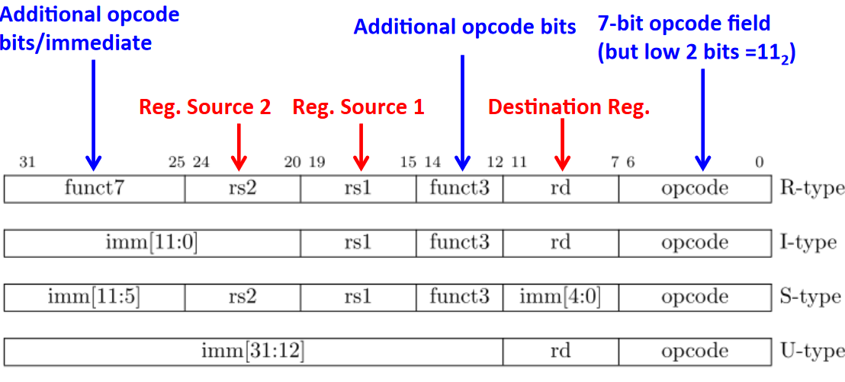
ISA supported

Slide 6
Progress
Implemented and tested ALU
Implemented and tested Control unit
Implemented and tested Data memory unit
Implemented and tested Fetch unit
Implemented and tested Register file

Slide 7
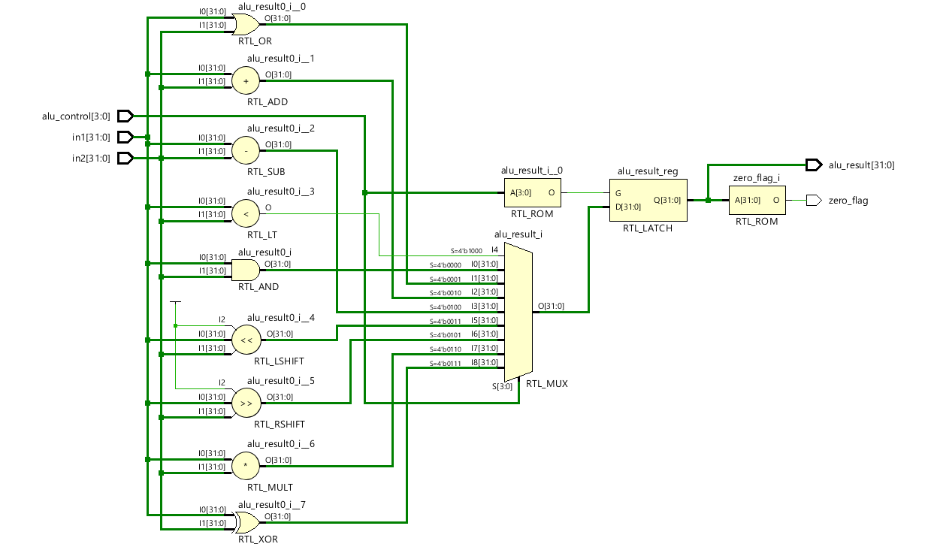
Alu
/*
ALU Control lines | Function
-----------------------------
0000 Bitwise-AND
0001 Bitwise-OR
0010 Add (A+B)
0100 Subtract (A-B)
1000 Set on less than
0011 Shift left logical
0101 Shift right logical
0110 Multiply
0111 Bitwise-XOR
*/

Slide 8
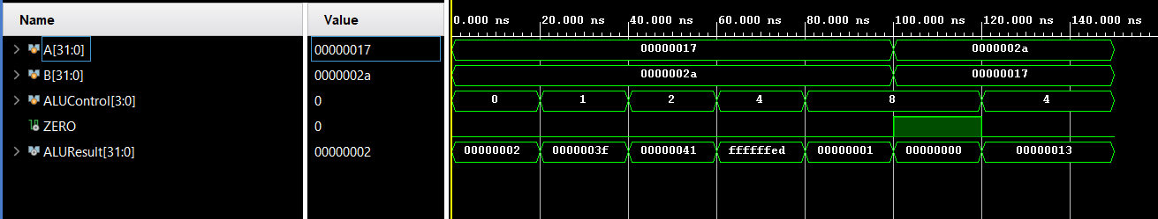
Alu testing

Slide 9
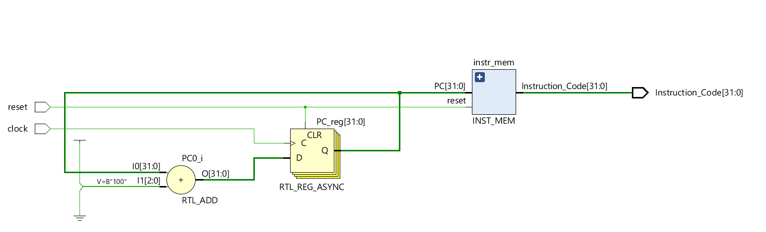
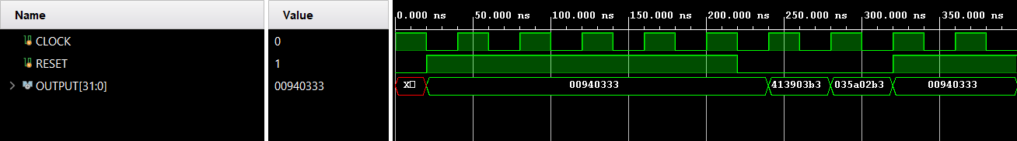
Memory unit

Slide 10
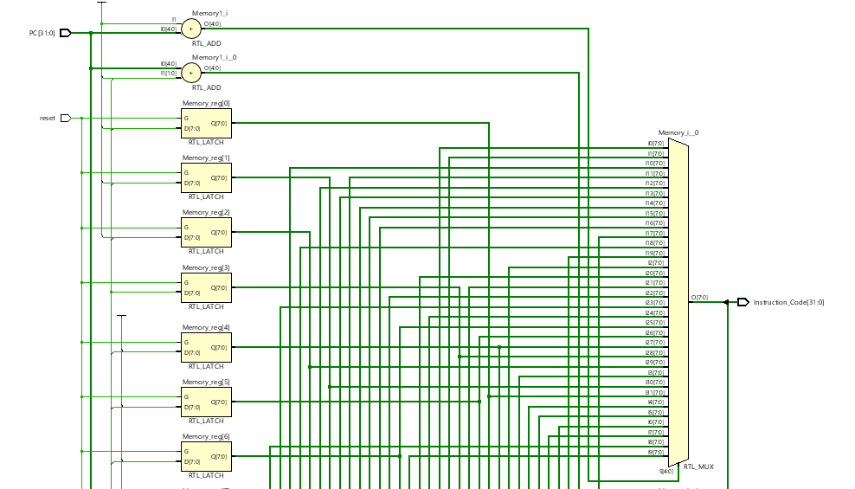
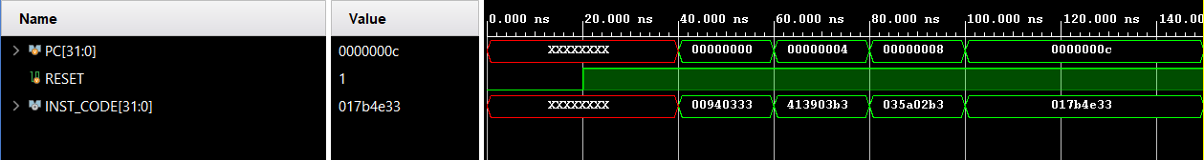

Slide 11
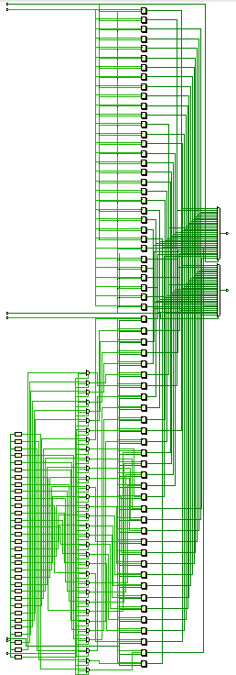
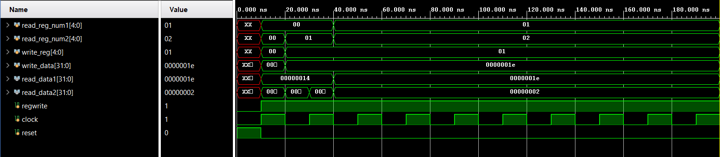
Register unit

Slide 12
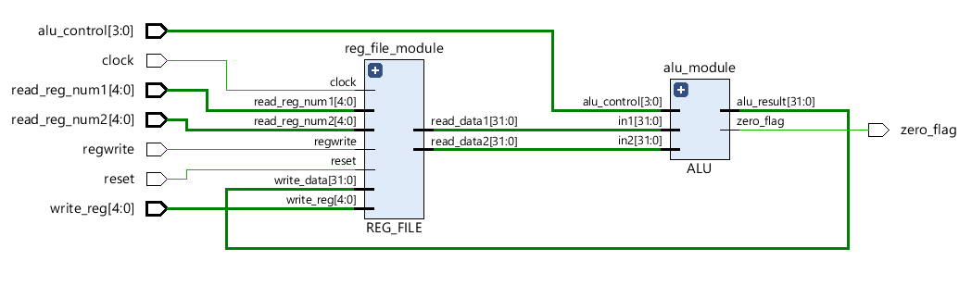
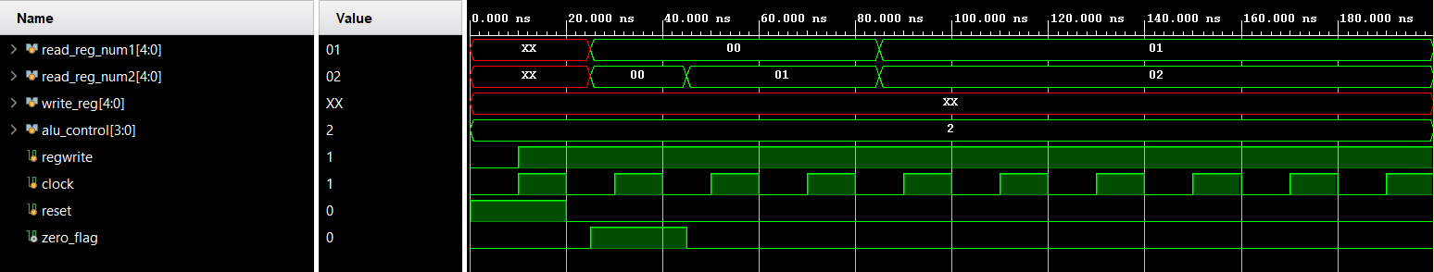
Data path

Slide 13
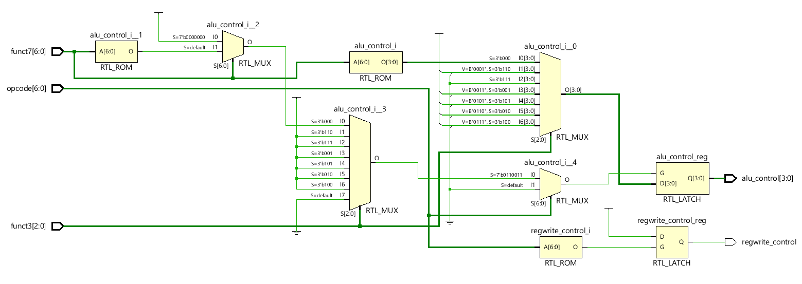
Control unit

Slide 14
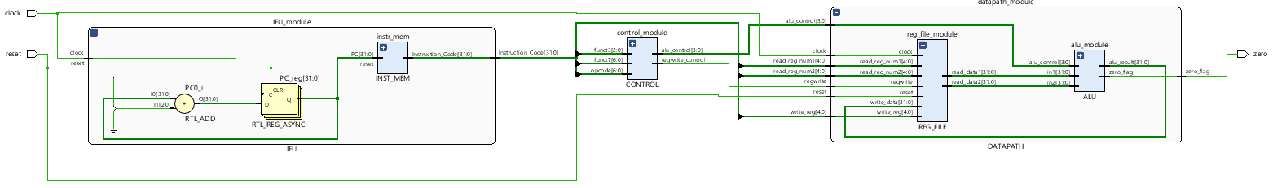
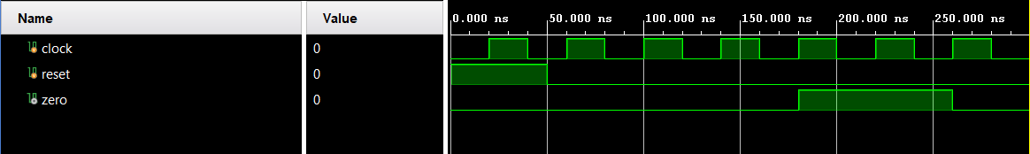
Processor

Slide 15
What needs to be done
Hazard control
Design optimization
Flushing
Cache unit

Slide 16
Thank you

